Slide 1
Poster design / presentations
Faculty of Engineering & IT

Slide 2

Acknowledgement of Country

Slide 3

Session aims
To better understand how to design an effective poster in terms of:
Your purpose and audience
Content
Visual appeal
Mechanics
Logistics
Photo by NordWood Themes on Unsplash

Slide 4
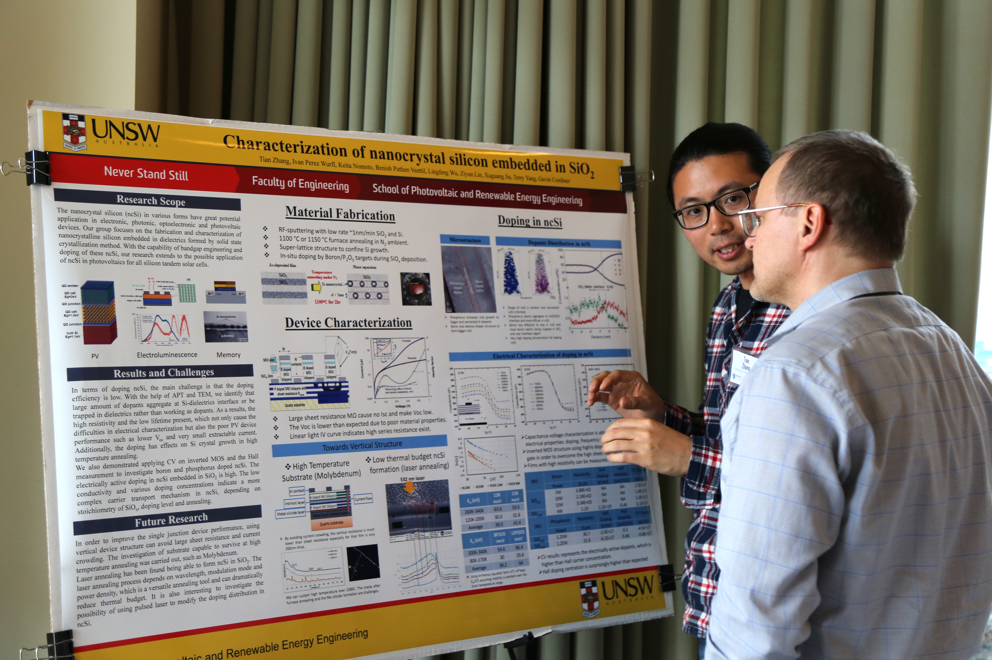
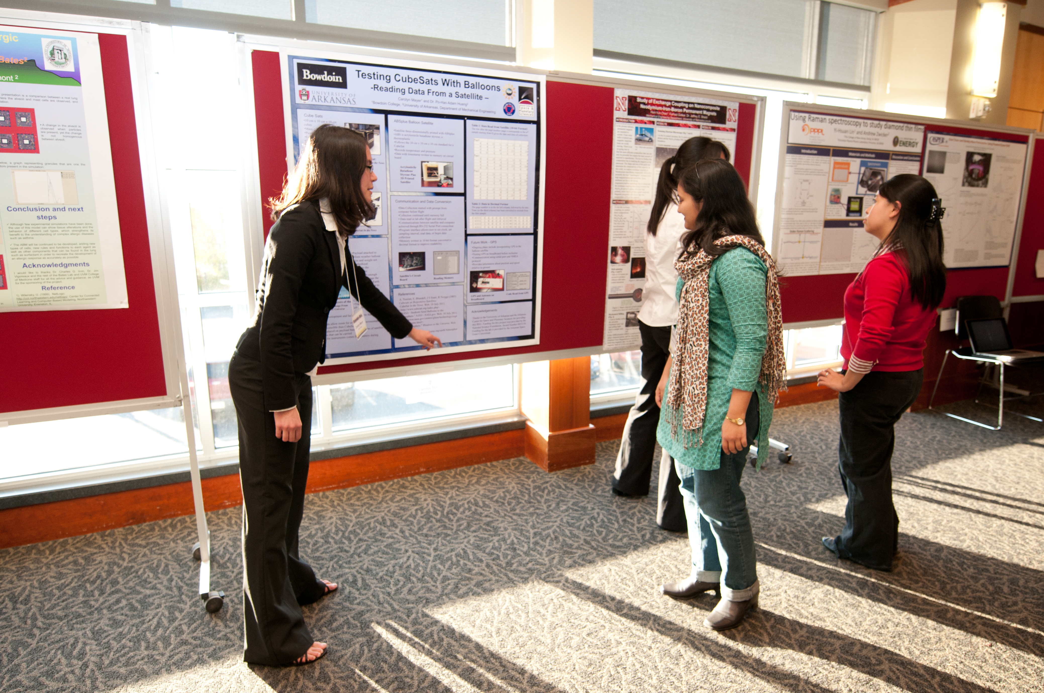
Poster presentations
Have you had any experience with academic posters and poster presentations before?
If so, what kind of poster has attracted your attention the most?
Notes:
Chat

Slide 5
Purpose of a Poster
A Conversation starter
Details are on your poster, in your head and in your notes.
An Advertisement
Generate interest in your research so that your audience wants to enquire further.
A Summary
Provide a succinct summary of what your research demonstrates.

Slide 6
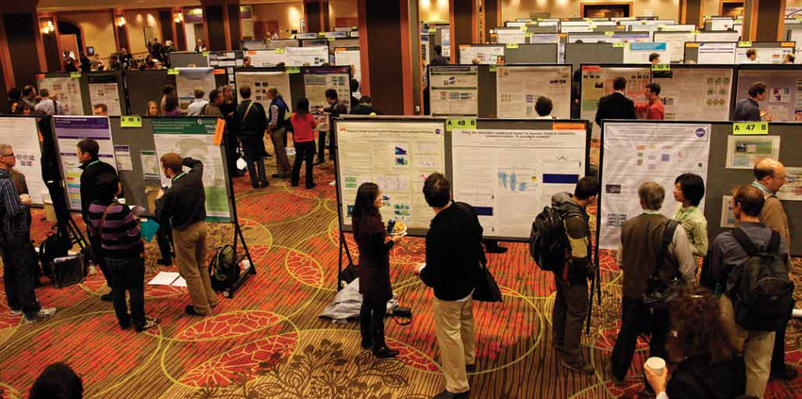
Applications of a poster
Conferences:
Poster presentation session- many researchers present simultaneously
Audience selects posters of interest
Can discuss one at length OR
Can browse many
General display:
thumbnail sketch of an institution’s research
useful for visiting researchers, politicians, other stakeholders

Slide 7
What are the main differences between oral presentations and poster presentations?
Posters are more flexible than oral presentations
Oral presentations vs. Poster presentations
Oral presentation | Poster
Limited time | Audience selects what to view and how long
Brief question time to whole audience | Opportunity for extended questions and discussion 1:1
Contains more detail in all sections | Is reduced to essentials: detail can be provided when you present it

Slide 8
Audience
3 types:
Experts in your field
Experts in a related field
Not expert in your field
Decides your terminology /use of technical language / focus of your poster

Slide 9
Select content based on the needs of your audience
Ask yourself:
What is the most useful/essential information relating to my project?
What will my audience most want to know?
What is the best medium to present this information?
  heading
  text
  graphic (chart, graph, image)
How can I show a direct connection between the text and the graphics?
How can I reduce the amount of text in order to maximise graphics/white space?

Slide 10
Content
Include only essential and useful information
Minimise text as far as possible
Organise under clear headings
Maximise use of graphs and pictures
Only use relevant graphics
Link all text and graphics

Slide 11

Headings and content
What are the advantages/disadvantages of this?
Use headings to help your audience to navigate the information on your poster
Some posters follow a research paper structure:
  Introduction/Aims/Objectives
  Methods
  Results
  Analysis/Discussion/Conclusions

Slide 12
Informative headings
Consider using informative headings: minimise text, maximise information
Do not waste text on ‘predictables’
Use key points as headings
e.g.
Results
OR
Gaze: ability to infer intent regardless of representation ✓

Slide 13

Reducing text
Carefully edit your text to maximise impact
To increase readability for a variety of audiences:
Distill your ideas down to your core message (50 words or less for each section)
Consider using bullet points
Write in plain English
Notes:
Presenting content

Slide 14
Visual appeal

Slide 15

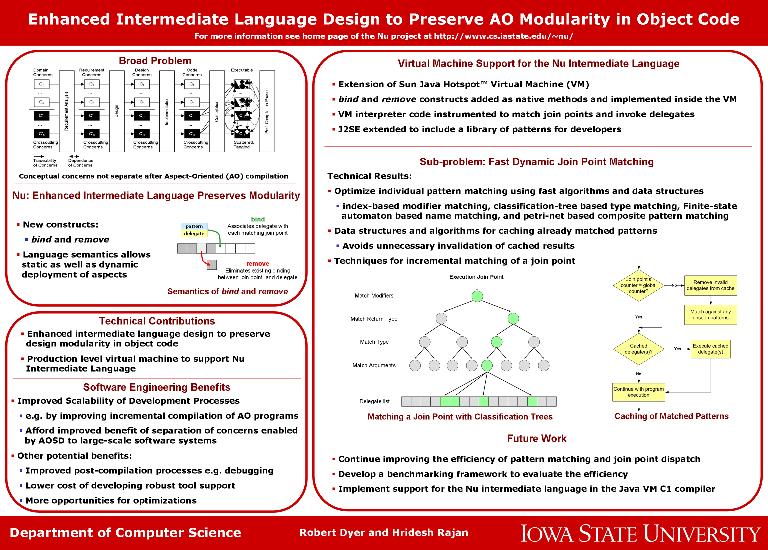
Compare 2 posters
Which poster has more accessible content? Why?
Notes:
Which poster looks like it has more accessible content?

Slide 16

Visual appeal: Layout
Where is your eye drawn first?
Use layout to help your audience to navigate the information on your poster
Notes:
Poll- where is your eye drawn first?

Slide 17
Visual appeal: Layout explanation
Visual appeal: Layout
Use layout to help your audience navigate the information on your poster
The layout of your poster should have clearly defined sections with a logical flow.
Eye tracking studies suggest the eye focuses most naturally where the lines intersect.
Audience comprehension is higher when content is laid out in a zig zag pattern.
41% of viewers will look here first |  | 20% of viewers will look here first
25% of viewers will look here first |  | 14% of viewers will look here first
​Majooni et al., 2017
Notes:
Visual appeal

Slide 18

Text
Minimise text, maximise graphics, tables, pictures
Use dot points where appropriate
Use suitably formal, everyday language wherever possible
Avoid jargon (consider audience)
Choose a limited range of colours - test for contrast and readability

Slide 19
Graphics
Keep them simple
Features should convey essential information (shading, appropriate numbering, reconsider background pictures)
All graphics and text should be legible from 1 -2 metres distance.

Slide 20





Graphics to reduce text
Cats reported to acquire xxxosis through contaminated prey such as birds or rodents and act as hosts to continue sexual reproduction, enteroepithelial cycle, and oocyst production (Dubey et al., 1970). Carnivorous animals from wild habitats such as skunks, raccoon, fox, bears also acquire toxoplasmosis through the ingestion of cysts from tissues. Human beings acquire toxoplasmosis by consuming half-cooked contaminated meat, such as lamb or pork (Dubey et al., 2005, Hill et al., 2010). The ingested tissue cyst is digested by the action of various proteolytic enzyme activities in the stomach of the host organism and release the parasite in the form of bradyzoites. The parasite is observed to be highly resistant to protease and survive in the host organism's small intestine. A report estimated more than 10 million cyst removal through fecal materials in cats within two weeks of ingestion. The released oocyst sporulates within five days of release in the environment. In the soil sample, the sporulated organism remains alive for about one year (Dubey, 1998).
Life cycle of xxxxosis

Slide 21
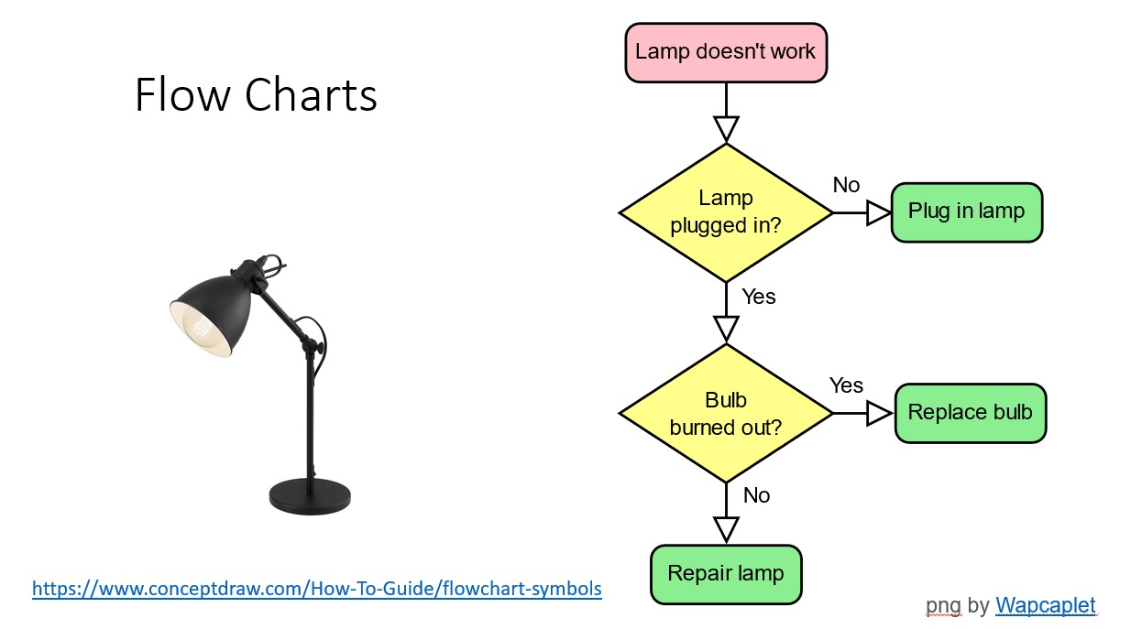
Flow charts

Slide 22
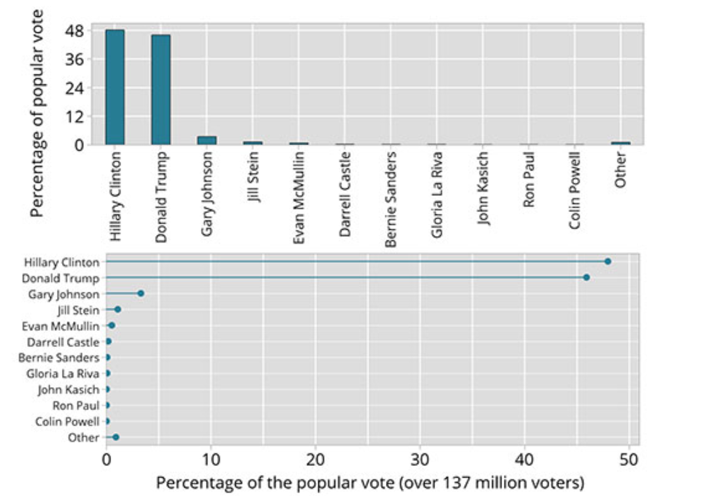
Graphs
Which graph is easier to read?
Why?

Slide 23
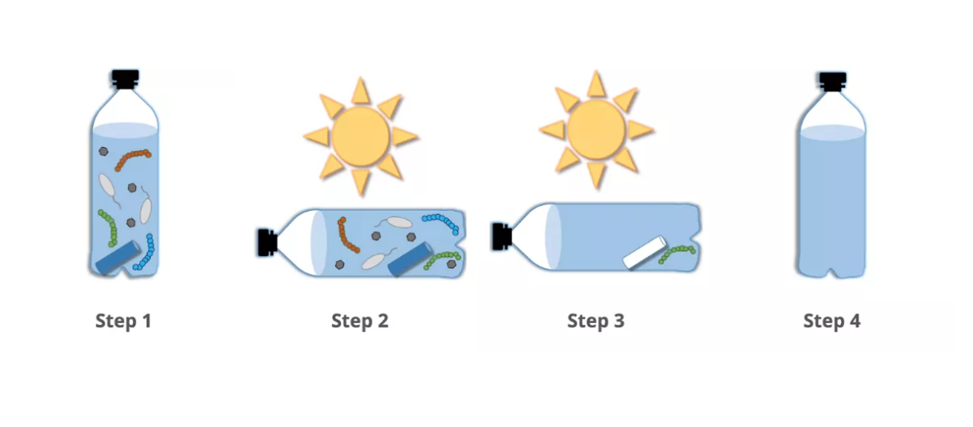

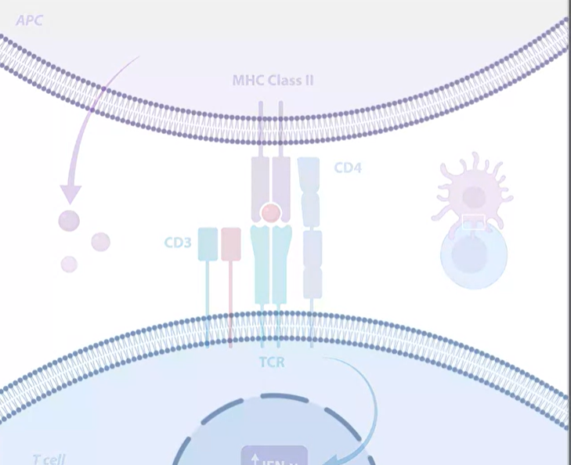
Diagrams
MS Office insert icons
https://thenounproject.com/
https://www.biorender.com/
(Diagrams and graphs)
Basic plan:
Up to five illustrations
Up to 50 objects on a canvas

Slide 24
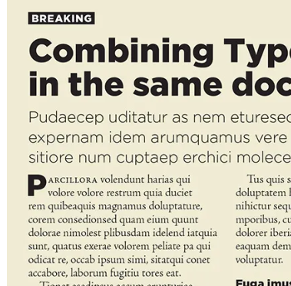
Font
Select font type and size to help your audience
Make your title readable from 1-2 metres away
Use consistent text sizes for different heading levels
eg.
  80 - 90 point for titles
  30 - 36 point for headings
  18 - 24 point for text
Put the names of all the authors and institutional affiliations just below (or next to) title but with smaller font
A serif font is more traditional (more legible at small scale)
A sans-serif font is more modern (and cleaner)
https://www.adobe.com/au/creativecloud/design/discover/serif-vs-sans-serif.html
Notes:
Visual appeal

Slide 25
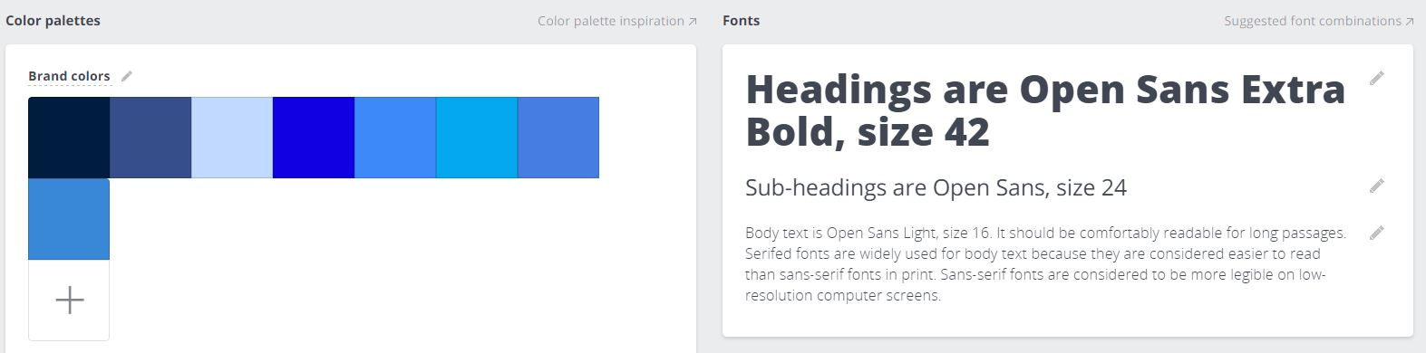
Colour
Carefully select and use a consistent colour and font scheme
Check for contrast of text on background colour
https://fonts.google.com/
https://designmodo.com/best-fonts/
https://coolors.co/
https://color.adobe.com/create/color-wheel/
https://paletton.com/
Notes:
Visual appeal

Slide 26
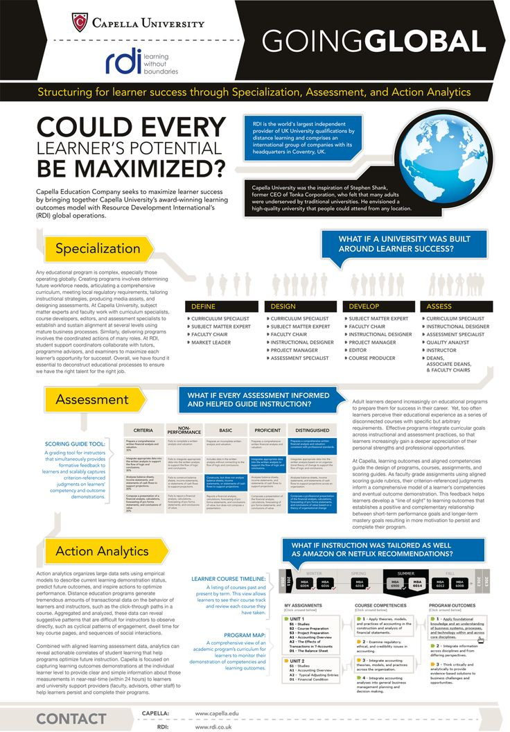
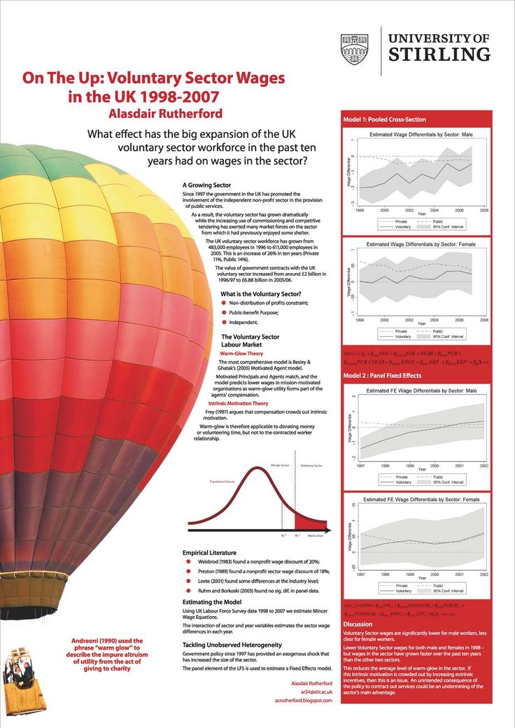
Consider these two posters
What do you like about the designs?
What would you improve?
Notes:
Visual appeal

Slide 27
Mechanics

Slide 28



Let the technology work for you
Notes:
Piktochart

Slide 29
Layout
Make ‘navigation’ clear: boxes for sections, numbering, logical sequencing
Balance texts and graphics
Consider display conditions when deciding on alignment of sections

Slide 30
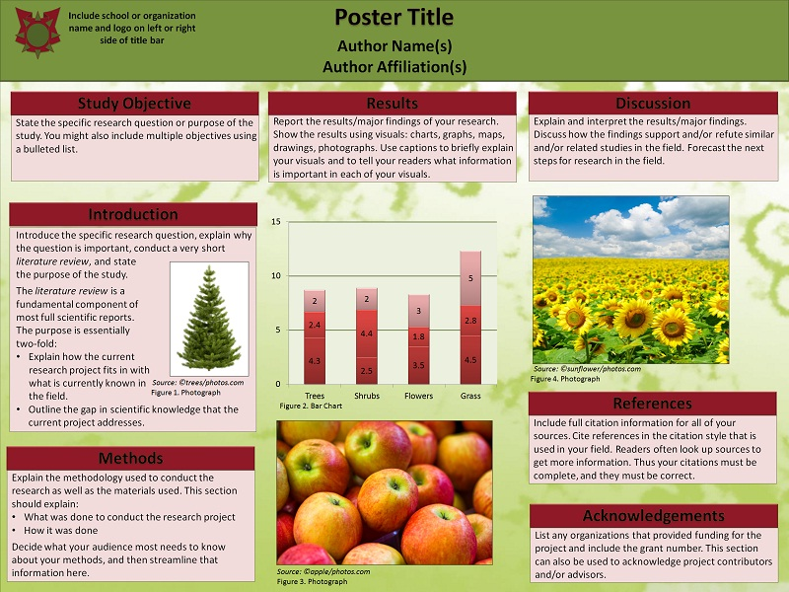
Example of clear layout

Slide 31
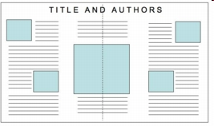
Balance text and graphics

Slide 32
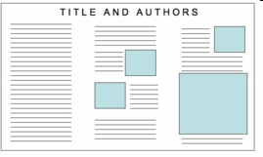
Don’t crowd a section with text

Slide 33
Using powerpoint to create poster
See: How to make an academic poster in powerpoint - YouTube

Slide 34
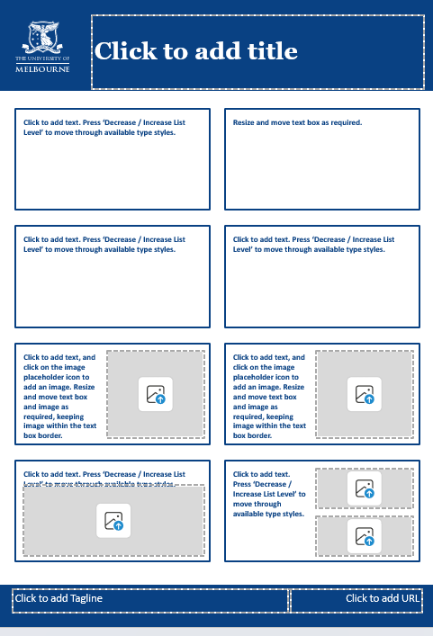
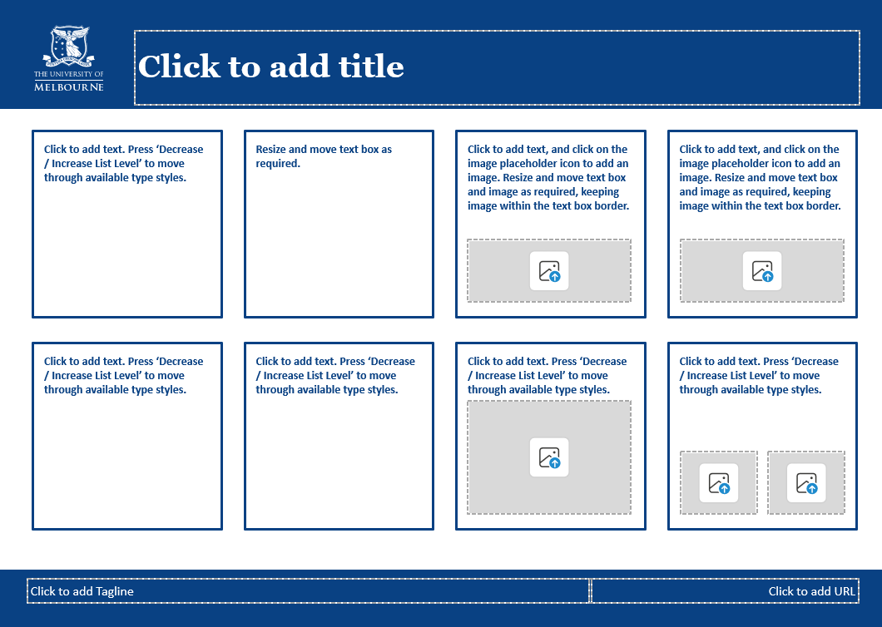
UoM templates

Slide 35
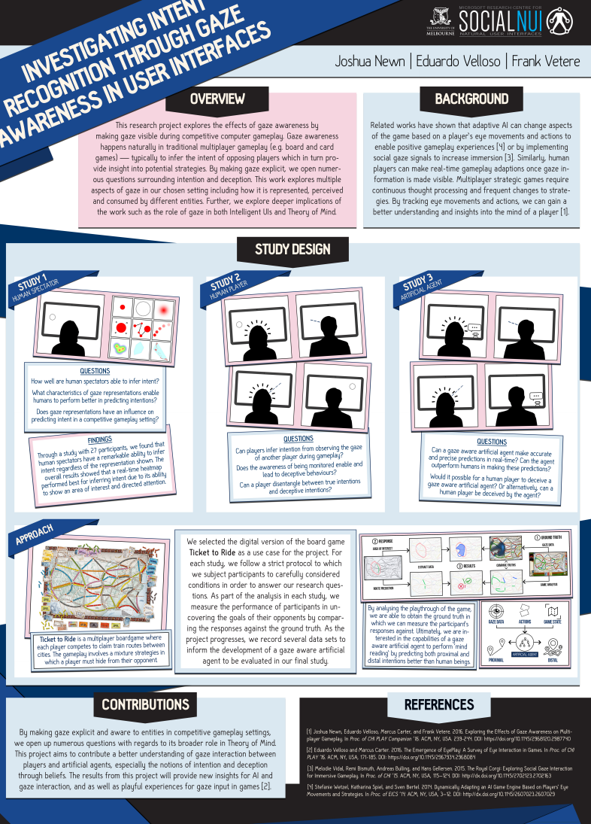
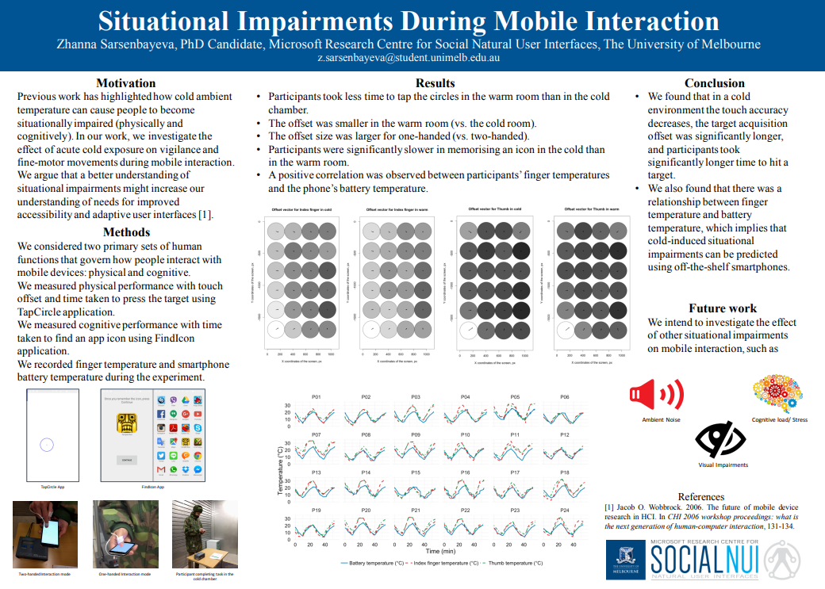

Previous examples
Discuss: use of layout, headings, visuals, text
URL: https://go.unimelb.edu.au/vv3p

Slide 36
Logistics

Slide 37
Prepare you poster in advance
Size = A1 (59.4 x 84.1 cm) LANDSCAPE or PORTRAIT
Format = PDF
University of Melbourne Templates available via submission page
Submit by Monday 20th Oct via the link on the CIS Doctoral Colloquium 2025 Poster submission webpage
See: https://cis.unimelb.edu.au/research/colloquium/cisdc-2025/dc2025-poster-submissions

Slide 38
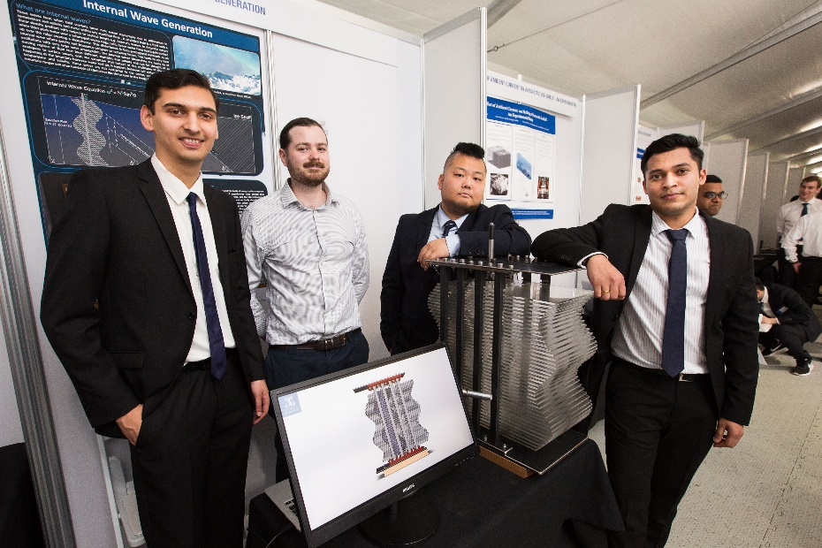
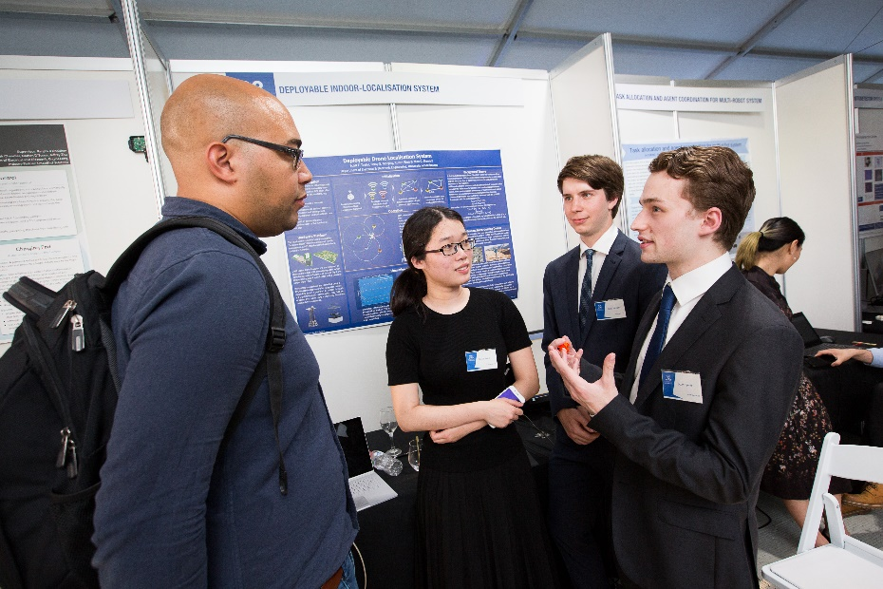
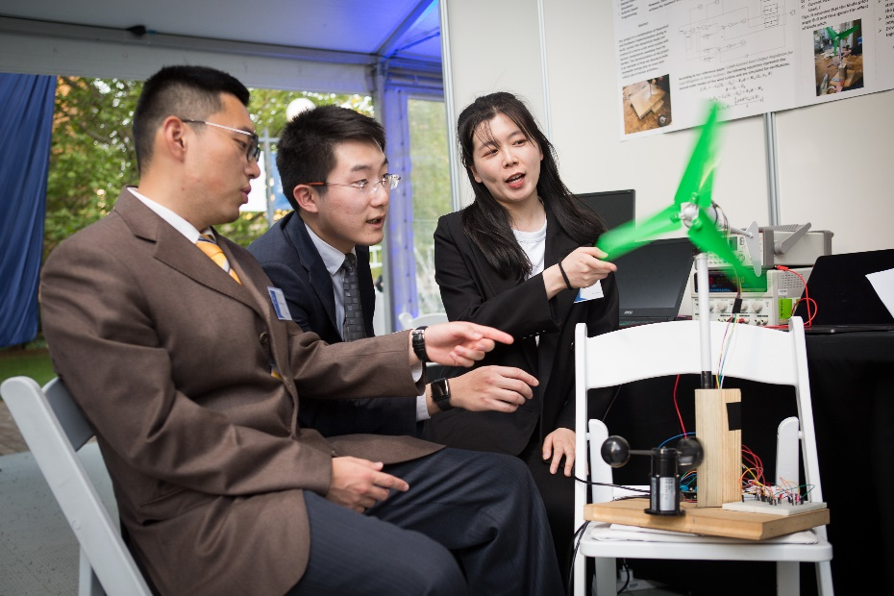
Consider where to position yourself …

Slide 39
Summary
Consider these elements when designing your poster:
Your purpose and audience
Content
Visual appeal
Mechanics
Logistics
Final tip:
Print out an A3 version
Get another set of eyes to look at it: Do they get it?

Slide 40
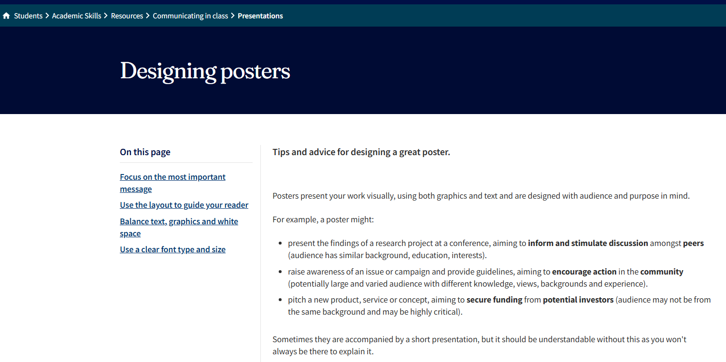

Further support

Slide 41
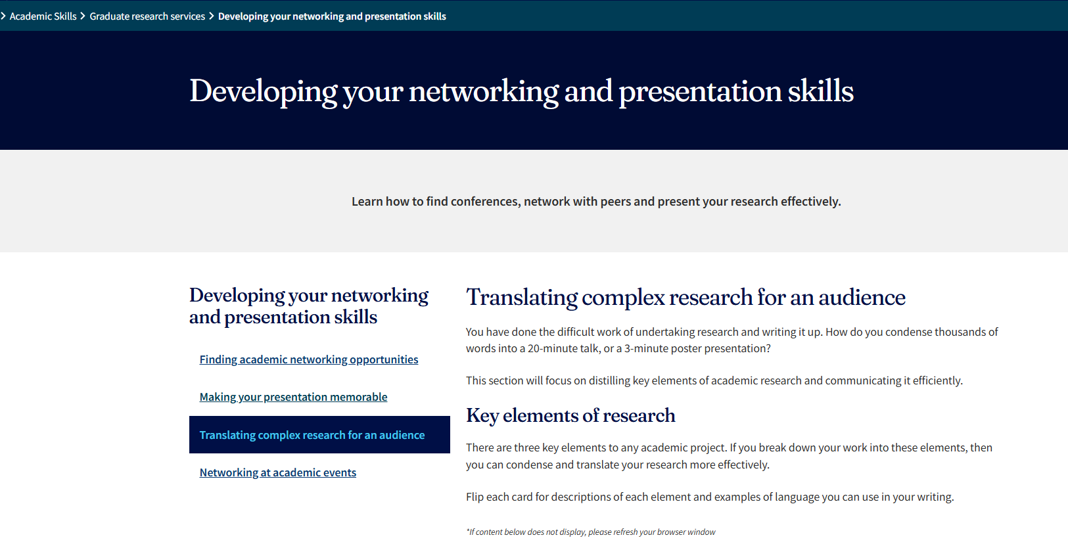

More resources

Slide 42





Academic Skills support
Academic Skills
students.unimelb.edu.au/academic-skills
Visit our website
Online resources
Workshops & courses
1:1 services
English language development
Academic English Tutorials
Diagnostic English Language Assessment (DELA)
English Language Workshops

